Slide 1

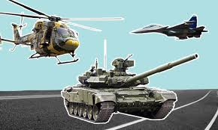
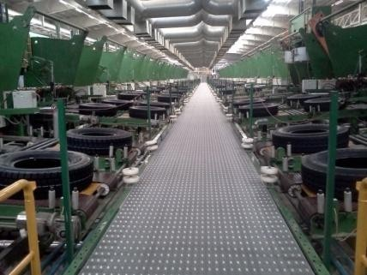

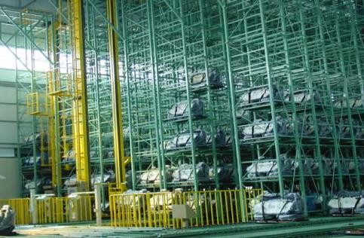
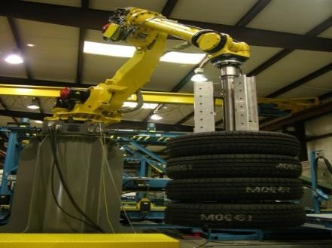
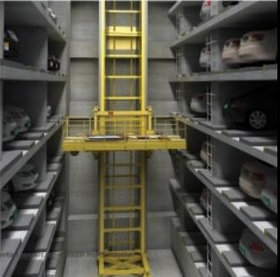
VARAM Automations (India) Pvt Ltd
(A VARAM Group Venture)
DEFENCE
AUTOMATION
ENERGY
WAREHOUSING
ROBOTICS
CAR PARKING

Slide 2
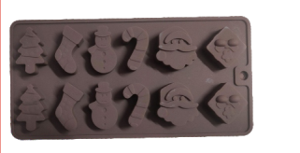
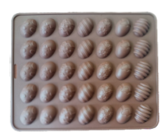
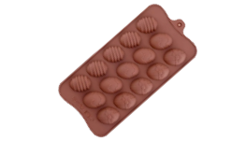
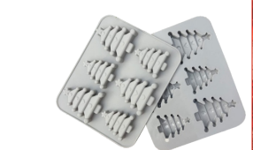
SILICONE CHRISTMAS CHOCOLATE MOULD
Item No | MB/3701
Item Name | Assorted-12
Size | 21 cm x 10.5 cm x 1 cm
Rate
Item No | MB/3702
Item Name | Easter-Egg-35
Size | 25.5 cm x 20.5 cm x 1 cm
Rate
Item No | MB/3703
Item Name | Easter-Egg
Size | 17.5 cm x 18.5 cm x 1 cm
Rate
Item No | MB/3704
Item Name | Christmas Tree
Size | 17.2 cm x 14.5 cm
Rate
Varam Automations

Slide 3
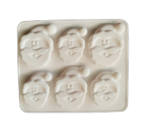
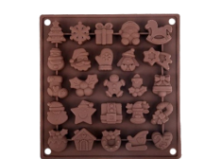
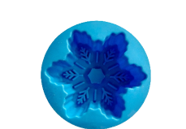
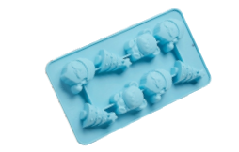
SILICONE CHRISTMAS CHOCOLATE MOULD
Item No | MB/3705
Item Name | Santa Claus
Size | 17.2 cm x 14.5 cm x 2 cm
Rate
Item No | MB/3706
Item Name | Assorted - 25
Size | 8 cm x 3 cm
Rate
Item No | MB/3707
Item Name | Snow Flake
Size | 20 cm x 10.3 cm x 1 cm
Rate
Item No | MB/3709
Item Name | Christmas Theme -8
Size | 21.8 cm x 12 cm x 2 cm
Rate
Varam Automations

Slide 4
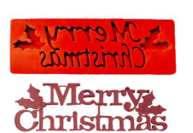
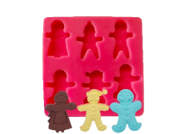
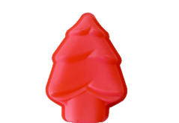
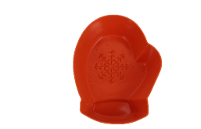
SILICONE CHRISTMAS CHOCOLATE MOULD
Item No | MB/3710
Item Name | Merry Christmas
Size | 18.3 cm x 5.8 cm x 0.5 cm
Rate
Item No | MB/3711
Item Name | Ginger Men - 6
Size | 8.8 cm x 8.8 cm
Rate
Item No | MB/3712
Item Name | Christmas Tree
Size | 13.5 cm x 10 cm x 2 cm
Rate
Item No | MB/3714
Item Name | Snowflake Glove
Size | 11 cm x 8.5 cm x 2.5 cm
Rate
Varam Automations

Slide 5
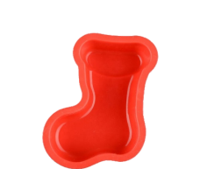
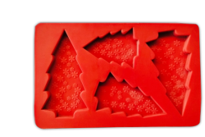
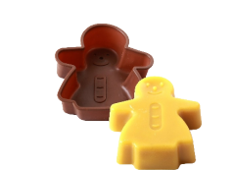
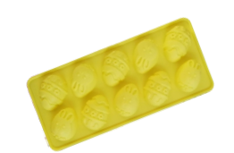
SILICONE CHRISTMAS CHOCOLATE MOULD
Item No | MB/3715
Item Name | Snowflake Shoe
Size | 11 cm x 8 cm x 3 cm
Rate
Item No | MB/3718
Item Name | Flat Christmas Tree
Size | 12.2 cm x 7.5 cm
Rate
Item No | MB/3716
Item Name | Ginger Women
Size | 13.5 cm x 10.5 cm x 3 cm
Rate
Item No | MB/3717
Item Name | Easter Egg-10
Size | 23 cm x 10 cm x 2 cm
Rate
Varam Automations

